Slide 1
Total Joint Replacements
Scott Silverstein M.D
Board Certified Orthopaedic Surgeon
Top Doctor- Baltimore Magazine
Sean McGiveron, PA-C

Slide 2
Klara- Text Messaging service
Post-Surgical questions
Scheduling appointments
Physical Therapy and Medications Refills
Klara is our HIPAA complaint messaging service that makes asking questions and receiving answers as easy as sending a text. This will bypass phone calls and phone messages for a quicker response.
Click Here: https://patient.klara.com/#/login or call Alex at ext: 2105

Slide 3
Important people
and Numbers
Dr. Silverstein’s office:
(410) 644-1880 ext. 2105- Alex- Secretary(Medication refills, Forms)
***allow 24 hours for refills. no refills on evenings and weekends
***allow 7-10 days for forms so plan ahead
Ext. 165 – Angie- Surgical Scheduler
(410) 646-3623- Fax
Durable medical equipment (Walkers, Ice machines, Canes ,Crutches, etc.)
(410) 644-1880 Ext: 249- Ashley (Eldersburg)
453- Josh (Columbia)
167- Kelly (Catonsville)
Northwest Hospital Pre-admissions
(410) 701-4386
University of Maryland Rehabilitation and orthopedics (Kernan) Pre-Admissions
(410) 448-6418

Slide 4
Benefits of surgery
Reduces or eliminates pain
Keeps you active for good cardiovascular health
May last for 20 years
Will not make you lose weight! A good diet preoperatively is key.

Slide 5
Interested in outpatient total joint?

Slide 6
Who is a candidate for outpatient knee replacements?
Body Mass Index under 40
Stable medical issues
Not taking pre-operative narcotic medications
Stable home support
Family or friend to be your coach

Slide 7
What are the advantages of outpatient total joint replacement?
Safety:
Avoid inpatients who may have infectious diseases, so there is less chance of diseases spreading between patients.
Newer anesthesia techniques to allow for pain relief and the ability to go home the same day.
Cost:
Surgery at a surgery center can cost half as much as surgery at a hospital, saving the patient money.
Recovery:
No staying in hospital means recovering in the comfort of your own home, immediately moving around and sleeping in comfortable surroundings without the interruptions of hospital staff.

Slide 8
Before Surgery
Prepare Home: Most falls happen at home, but are preventable.
Make a livable space on one level if possible (yes you can do steps, but not more often than you have to)
Remove obstacles from walkways
Keep a flashlight close with new batteries for night time walking
Arrange a caregiver for a few days if you live alone
Remove rugs/runners that pose a tripping hazard, check the railing for the stairs, bath bench, toilet seat riser, or grab bars.
Walker/Crutches/Cane for post-operative ambulation
Contact our Durable medical equipment specialist if you need these items
Consider home ice machine and/or portable compression devices
Try practicing using them properly before the operation

Slide 9
Tips for preparing
your home
You and your family must consider these tips before your surgery to help make your home as safe and comfortable as possible for your return after surgery:
• Arrange furniture that can be an obstacle while using walker
• Move important things to waist level to avoid bending and reaching
• Use stairs with handrails that are securely fastened to walls
• In homes with a lot of stairs to second level, you may need a bed, portable toilet on first level
• If you have pets you may want to arrange boarding them first few days you are home
• A recliner can be used to help elevate the legs
• Prepare or purchase meals ahead of time to minimize cooking after surgery
• Have working night lights in bathrooms, bedrooms, and hallways you will be using frequently
• Do laundry ahead of time
• Get a non-slip bathmat or bath rug

Slide 10
Reduce risks &
Complications
Stay active – Exercise before your surgery and do“Prehab” for a few weeks with one of our therapist.
Healthy diet - Before your surgery, avoid foods that increase inflammation in your body such as high sugar foods . Aim for fresh foods, including fresh fruits, vegetables and nuts.
Manage diabetes and other – Talk to your PCP
Reduce, eliminate tobacco. Smoking increases your risk of developing wound infection so we encourage you to try to stop before your surgery
Reduce, eliminate alcohol. Hazardous alcohol use (3 or more drinks per day) can increase your risk of postoperative infections, cardiopulmonary complications and bleeding risk
Try to minimize or stop preoperative narcotic usage to make pain easier to control after surgery.

Slide 11
Precautions
Dental work – must be completed 3 months after your surgery or 2 weeks before. Refer to the ADA or your dentist for antibiotic use after procedures (most patients do not require prophylaxis antibiotics after this if you are not chronically ill).
Shaving – do not shave your legs or use any hair removal products near the surgical site 5 days prior to surgery.
Special nasal swabs should be used twice a day for 5 days prior to surgery to prevent infection this will be prescribed to you at date of signing up for surgery with Dr. Silverstein or Sean McGiveron PA-C.
Stop all NSAIDs (Advil, Aleve, Motrin) EXCEPT Celebrex, Meloxicam or baby aspirin at least 5 days prior to your surgery. Many herbs and supplements can cause bleeding and should be discontinued preoperatively. You may always continue to take Aspirin as directed by your primary care physician for any orthopedic surgery .
Any questions about your current other medications refer to your PCP.

Slide 12
Hospitals pre-surgical class
We strongly recommend you attend the total joint class even if you had a previous joint replacement. Classes (Live or virtual) are offered to replacement patients to get familiar with facilities and get tips on pre-operative and post-operative care.
Pre-admission testing
Northwest Hospital
(410) 701-4386
University of Maryland Rehabilitation and orthopedic institute (Kernan)
(410) 448-6418

Slide 13
Total knee replacement
Knee Replacement informational video
https://zimmerbiomet.tv/videos/109
How is a Knee Replacement performed
https://zimmerbiomet.tv/videos/1624

Slide 14
Total HIP replacement
Hip Replacement informational video
https://zimmerbiomet.tv/videos/110
How is a Hip Replacement performed
https://zimmerbiomet.tv/videos/1623

Slide 15
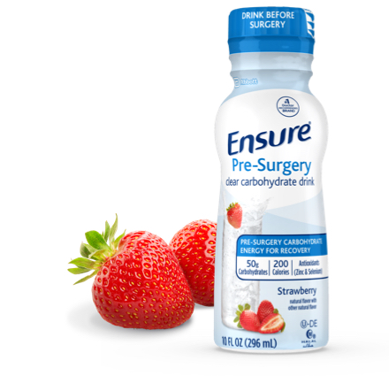
WHERE TO BUY: Major retail pharmacies(CVS, Walgreens ,ect)
Ensure® Pre-Surgery Clear Carbohydrate Drink
Formulated to help your body prepare for, and recover from, surgery
Every drink has:
50 grams carbohydrates
Antioxidants: zinc, selenium
200 calories
Refreshing strawberry flavor
Gluten-free
Suitable for lactose intolerance†
Halal
Kosher
How to use:
Drink 1 bottles the night before surgery during your fasting window, before you go to sleep for the night
Drink 1 bottle the morning of surgery, 2 hours before surgery
Pre-Surgery Nutrition

Slide 16
Day of Surgery
*IMPORTANT*
Please, nothing to eat or drink after midnight including coffee, water, gum, hard candy, etc. Except for Ensure Supplement Drink Clear 2 hours before surgery. **You cannot drink any other type of supplement drink**
You will be called by the hospital or surgery center a day or so before with the time to arrive. Generally, they will bring you in 2 hours before your surgery time to have you ready.
You may shower the night before or the morning of surgery. The use of a chlorhexidine scrub like “Hibiclens” may help to reduce skin bacteria. Skin cleaner available for purchase at major retail pharmacies( CVS, Walgreens, ect)
Take any medications that were pre-approved by your PCP on the morning of surgery with a sip of water.

Slide 17
Post operative pain
You can be as asleep during surgery as you want, but spinal anesthesia makes it much easier to get up the day of surgery
A nerve block will help limit your pain – the anesthesiologist will do this
At Northwest they may put in a block that lasts even once you go home
EXPAREL – a long acting (3 day) local can be used at Northwest and Ellicott City Surgery Center(Outpatient) only (not at Kernan / U of MD)
Ice
Pain medications – obviously wean these as able, as they can constipate you

Slide 18
What to bring
to hospital
If you have Advance Directives please bring them with you
Current list of medications and dosages
Insurance card and current photo id
Personal care items
Comfy Shoes/Slippers – your legs and feet will be swollen following surgery so make sure they are not tight
Loose fitting clothes for PT
If you use a CPAP machine at home bring it with you
DO NOT bring jewelry or large amounts of money
**A locked locker will be provided for your personal belongings that will be given back after surgery***

Slide 19
Ice therapy
Ice therapy machine will be applied to your knee after surgery is finished.
Ice therapy helps decrease the swelling and aids in decreasing inflammation post-operatively.
Great for post surgery and drug-free pain relief. The system uses a motorized pump to circulate cold water from a cooler to the desired body area

Slide 20
Portable compression devices
Method of DVT prevention that improves blood flow in the legs. This imitates walking and helps prevent blood clots. These devices are battery powered and work by automatically inflating and deflating to promote blood flow.
Portable meaning you can use at home or in the car for further DVT prevention on the go or while you rest.
Ensure patients have maximum mobility during recovery in their blood clot prevention
We will discuss more blood clot prevention including these portable devices at your pre-surgical visits.

Slide 21
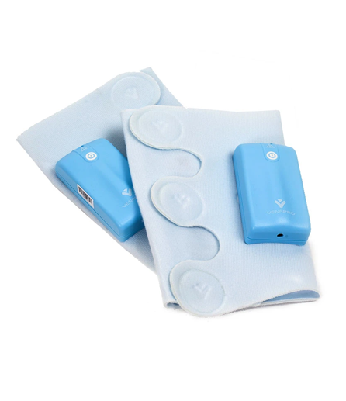
Portable compression devices
Rechargeable battery powered
Universal sizing for most calf sizes

Slide 22
Post operative
Home Health will come to your home for Physical Therapy. Details on your agency will come from the hospital social worker.
The week before you want to start outpatient therapy please call us for a prescription at (410) 644-1880 x2105
Your first post operative visit at 4 weeks will be scheduled with your surgery
If you experience severe calf pain / swelling with or without breathing difficulty, you will need an ultrasound to rule out a blood clot.

Slide 23
Do you have questions?
Stay in touch with us
410.644.1880 x2105
www.mdbonedocs.com
Note: Dr. Silverstein is not a consultant for any products he is using during your surgery.

